Slide 1
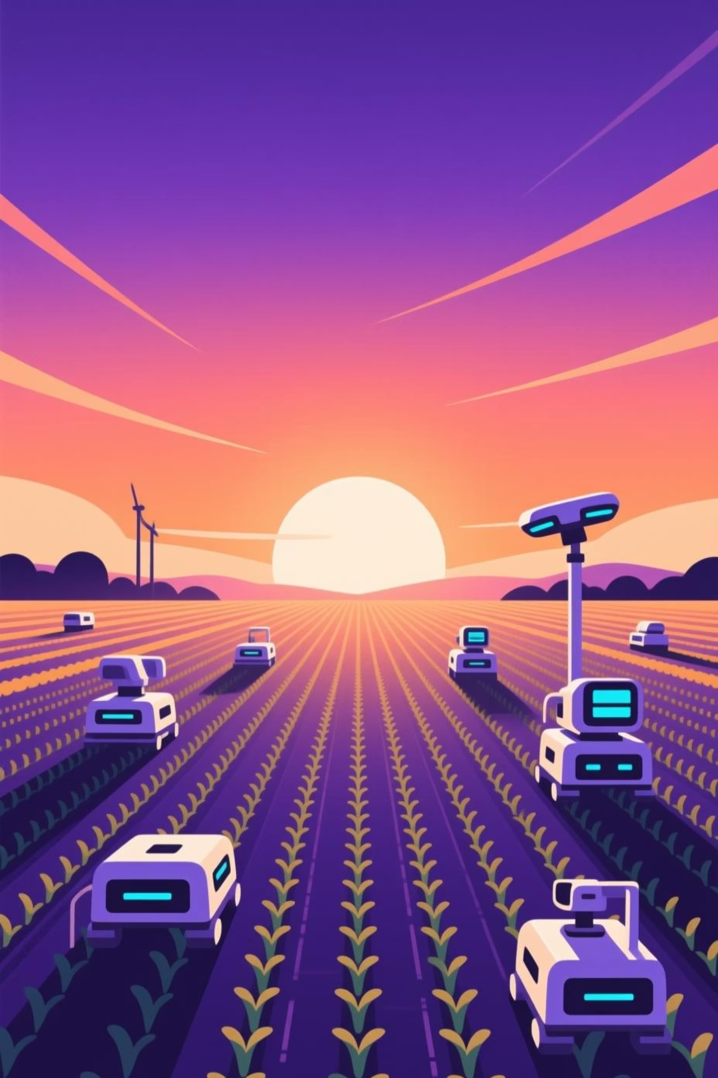
AgroBot Universal
AI-Based Agricultural Assistant
Empowering farmers worldwide with instant, intelligent agricultural guidance through multilingual AI assistance and visual crop diagnostics.
Submitted by Aarti Patel
Gmail:aartipatel0427gmail.com

Slide 2


The Challenge Facing Modern Farmers
Crop Disease Detection
Delayed Expert Advice
Language Barriers
Farmers struggle to identify diseases early, leading to crop loss and reduced yields. Traditional methods require expert consultation, which is often unavailable in remote areas.
Agricultural extension services are overburdened and slow to respond. Time-sensitive issues escalate while farmers wait for guidance, resulting in economic losses.
Technical agricultural information is often available only in dominant languages, excluding smallholder farmers who need support most urgently.

Slide 3






Introducing AgroBot Universal
An intelligent web-based assistant that breaks down barriers to agricultural knowledge, providing instant support in multiple languages with AI-powered diagnostics.
Multilingual Chat Interface
Image-Based Diagnosis
AI-Powered Intelligence
Upload photos of crops for immediate AI analysis, identifying diseases, pests, and nutritional deficiencies with high accuracy.
Leveraging advanced machine learning models to deliver accurate, context-aware agricultural recommendations.
Farmers ask questions in their native language and receive expert guidance instantly, eliminating language barriers.

Slide 4
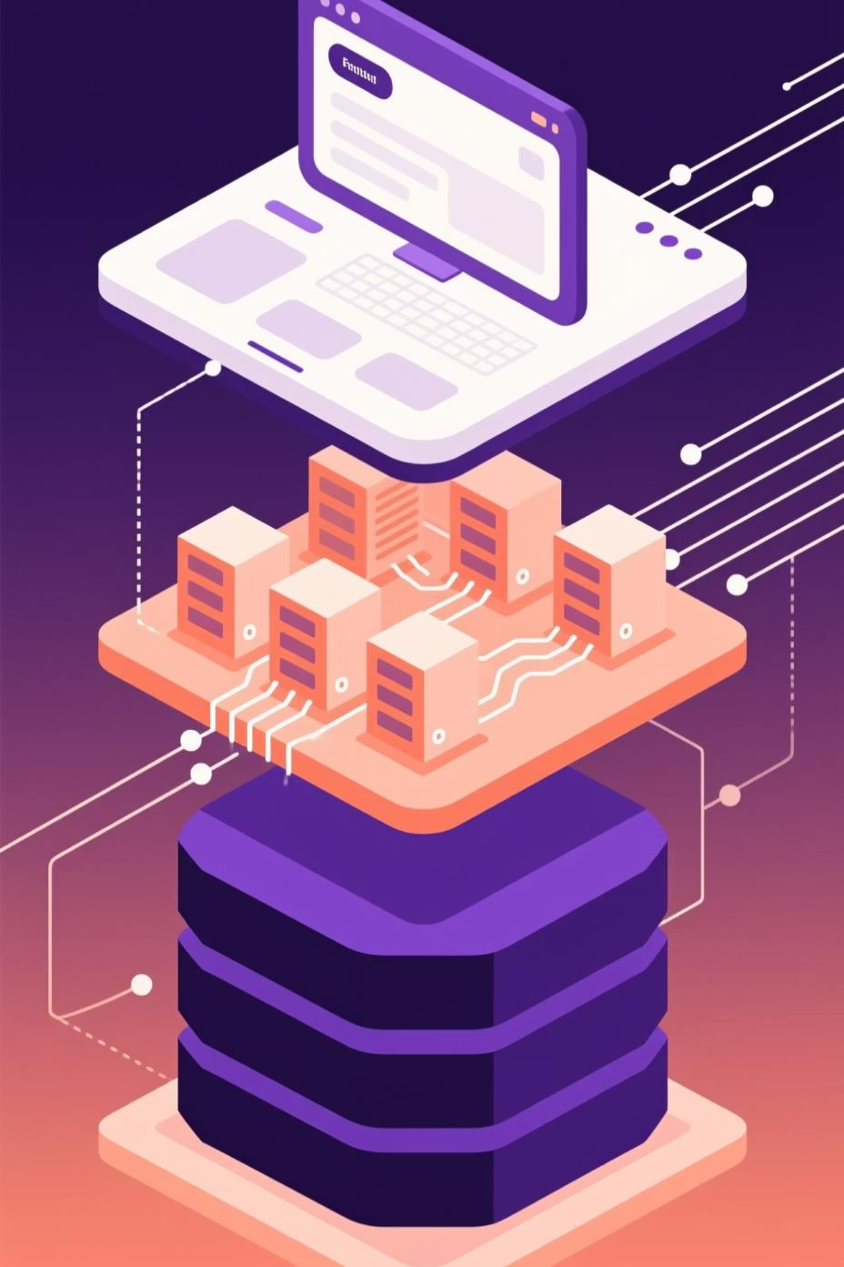



System Architecture
AgroBot Universal employs a scalable three-tier architecture designed for reliability, performance, and easy maintenance.
Frontend Layer
Responsive web interface built with HTML, CSS, and JavaScript for seamless user experience across devices.
Application Layer
Python Flask framework handles business logic, API integration, and request processing with robust error handling.
Data Layer
SQL database and CSV storage manage user data, query history, and agricultural knowledge base efficiently.

Slide 5
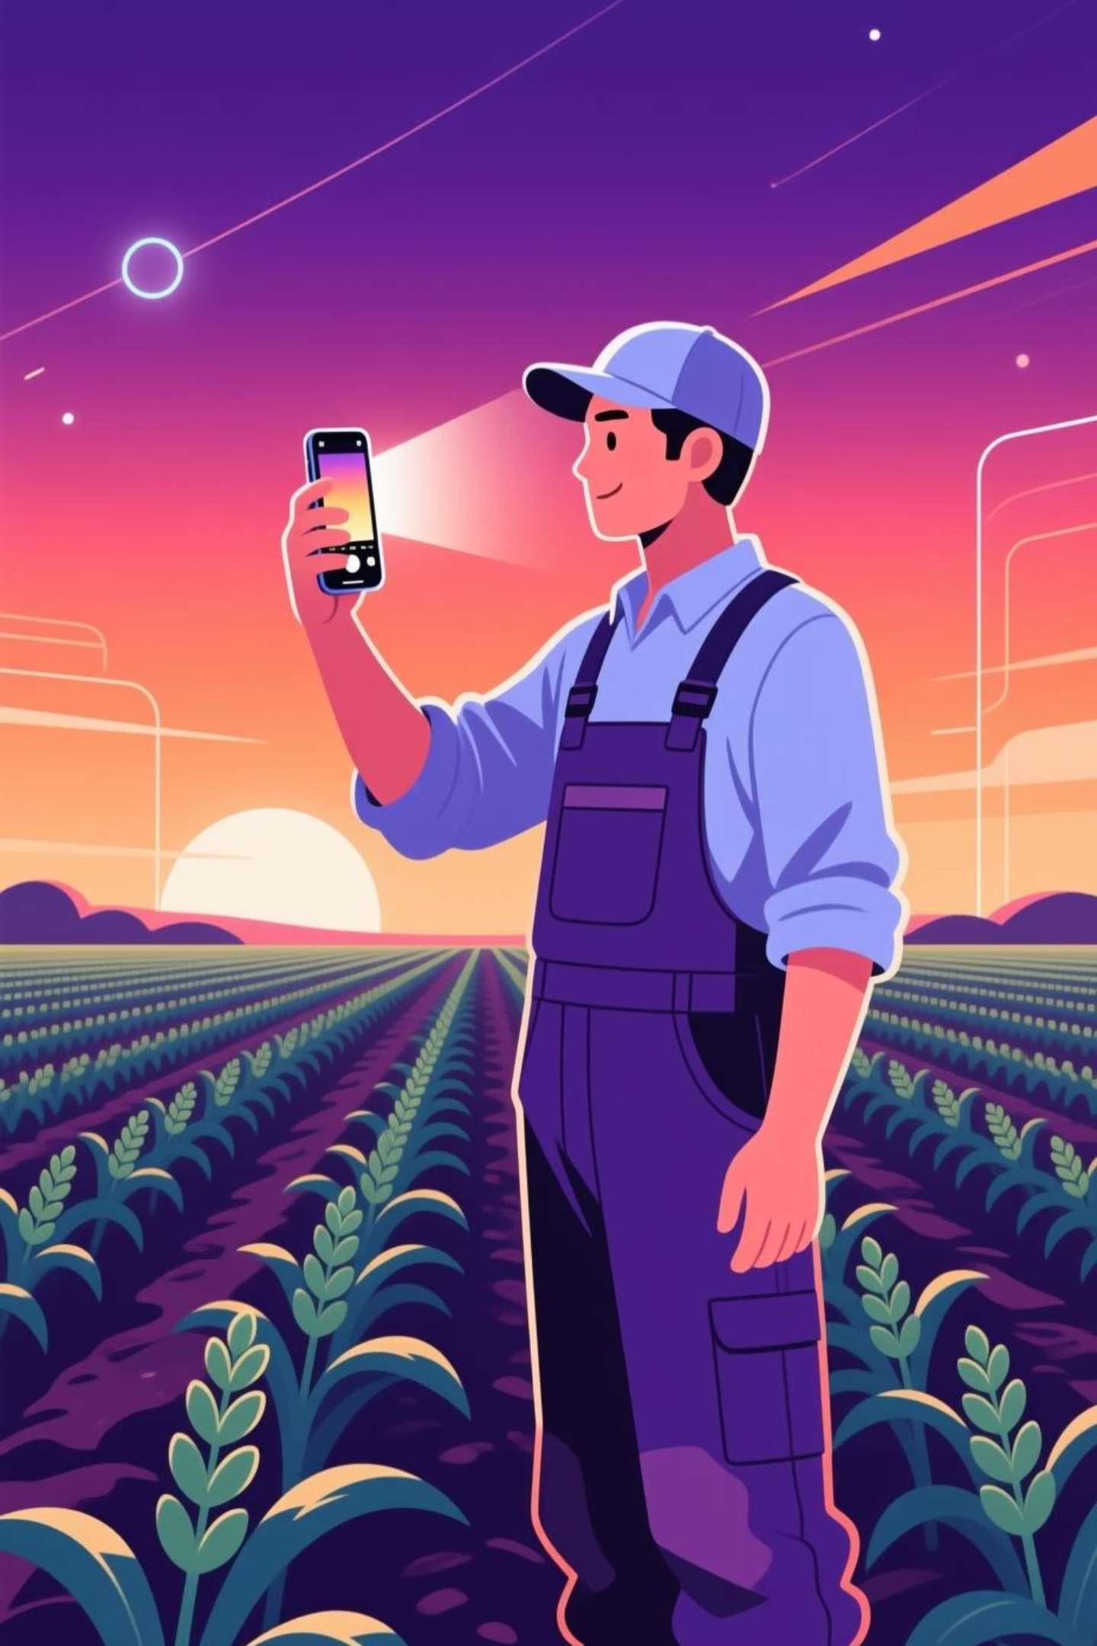

How AgroBot Works
A streamlined workflow ensures farmers get answers quickly, whether they're asking questions or seeking visual diagnostics.
01
User Authentication
Farmer logs into the secure platform using credentials, accessing personalized history and recommendations.
02
Query Submission
User either types a question in their preferred language or uploads an image of the affected crop.
03
AI Processing
OpenAI models analyze the input, cross-reference agricultural databases, and generate accurate, actionable insights.
04
Instant Response
System delivers clear, contextualized answers with treatment recommendations, prevention tips, and follow-up guidance.

Slide 6
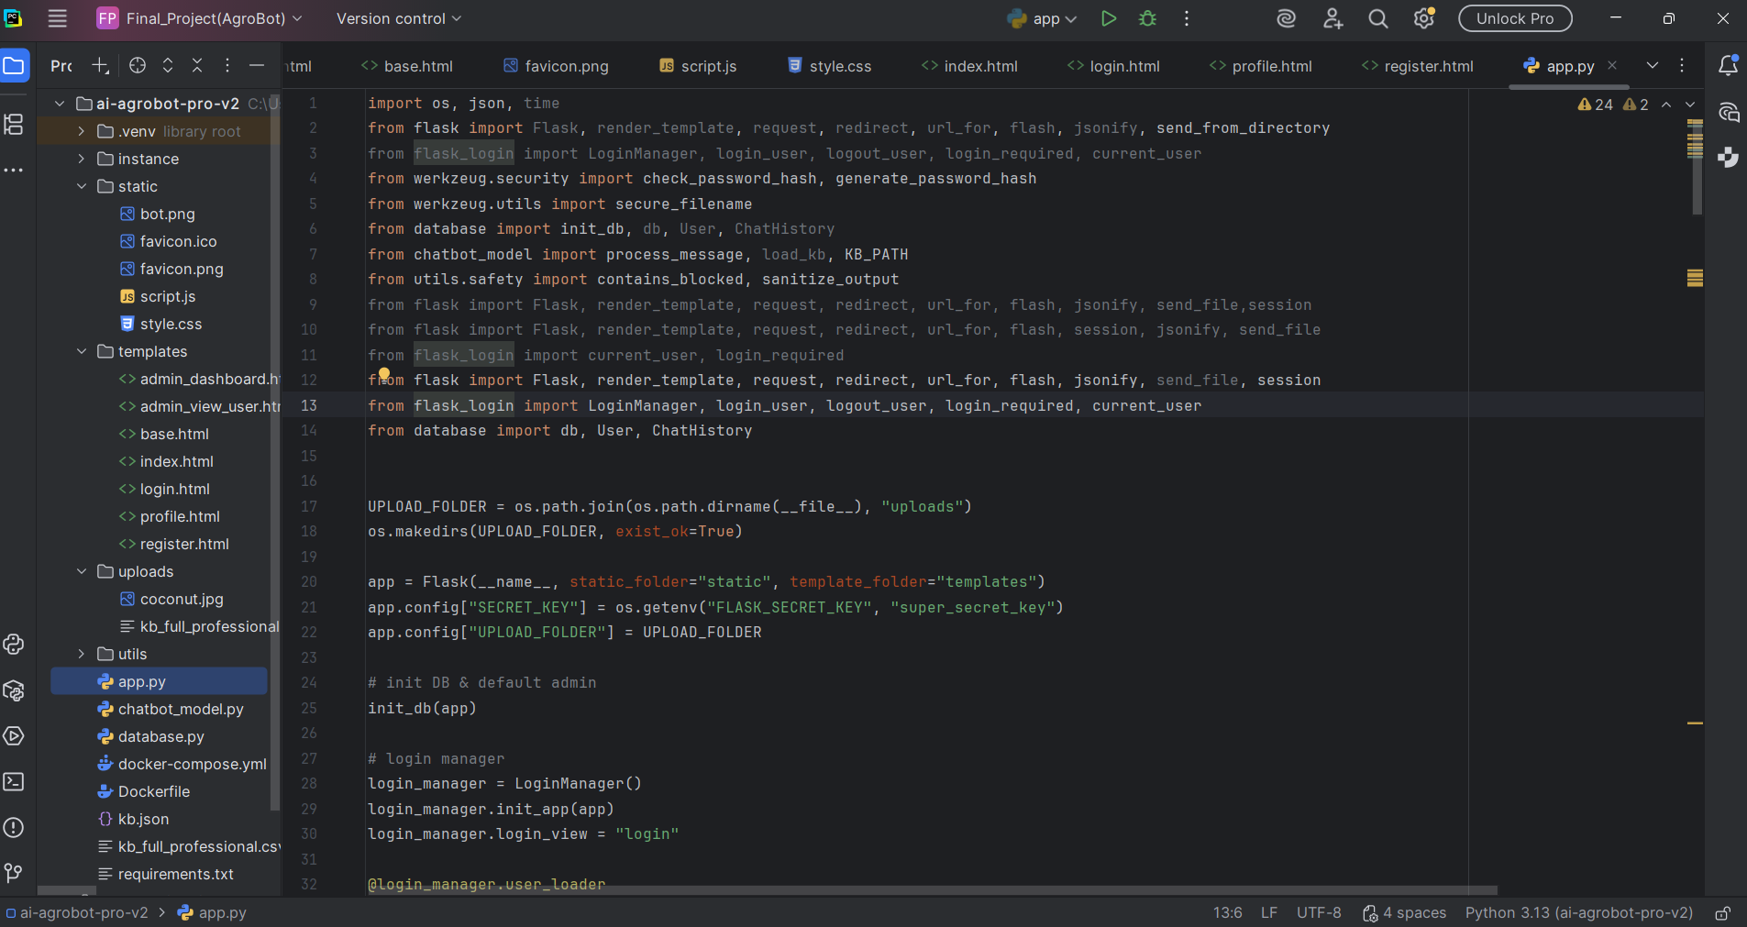
app.py Code :

Slide 7
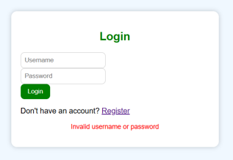
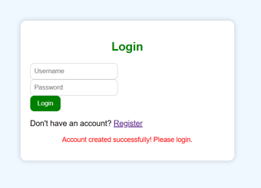
User Authentication:

Slide 8
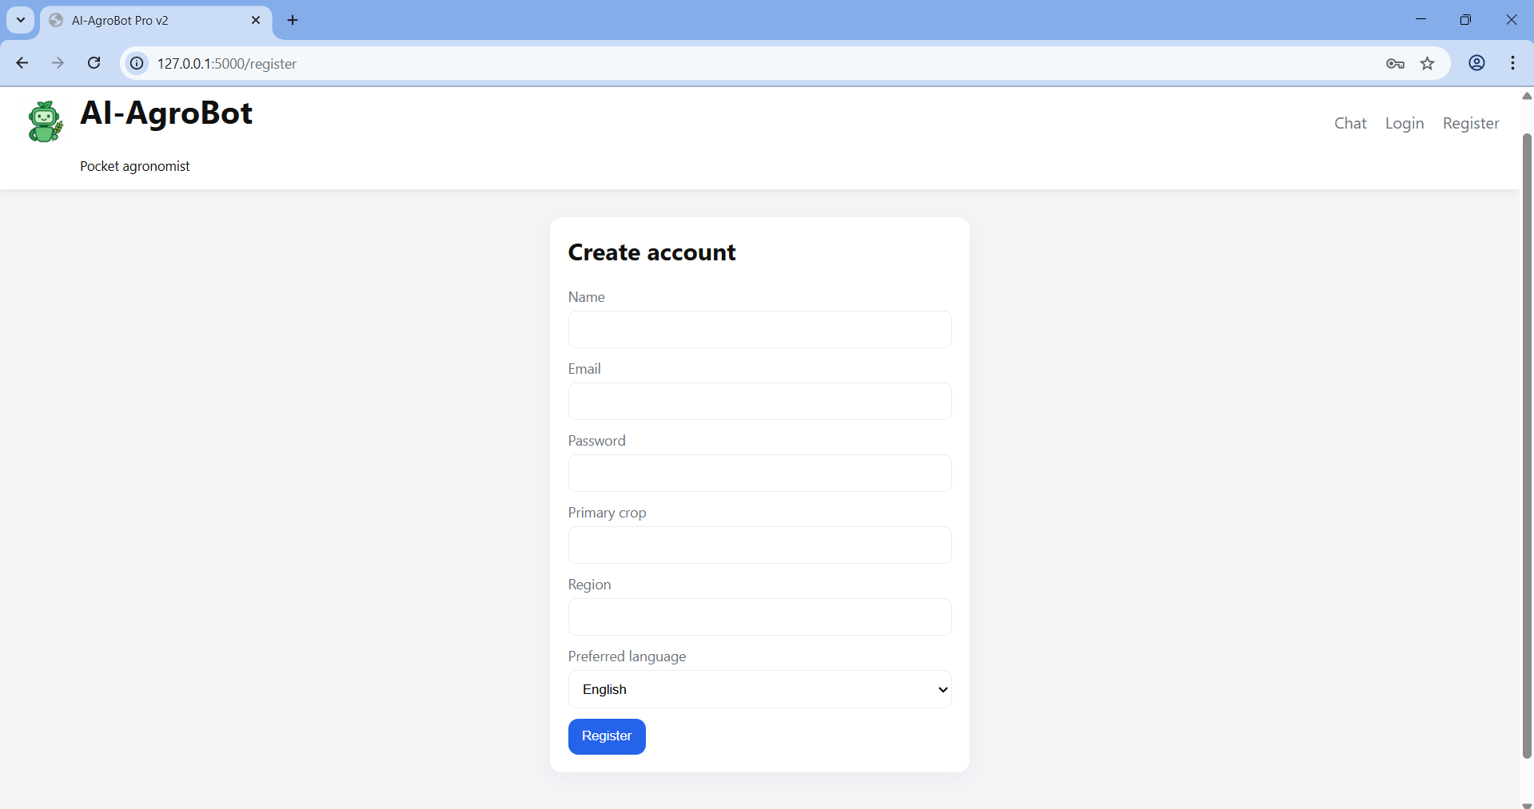
Create Account :
ion

Slide 9
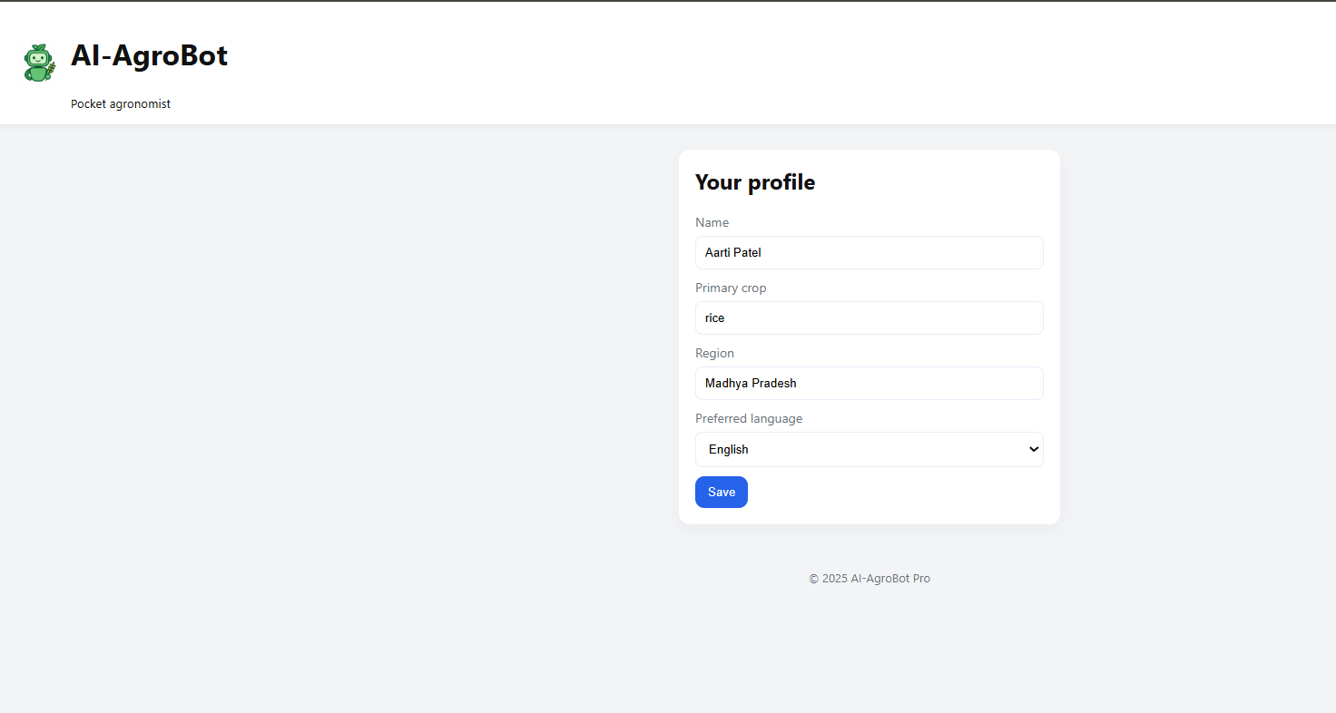
User Registration :

Slide 10
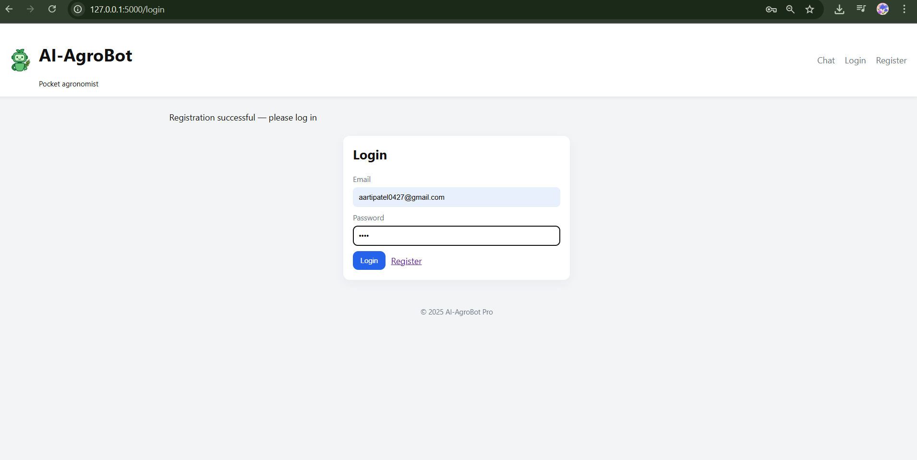
User login :

Slide 11
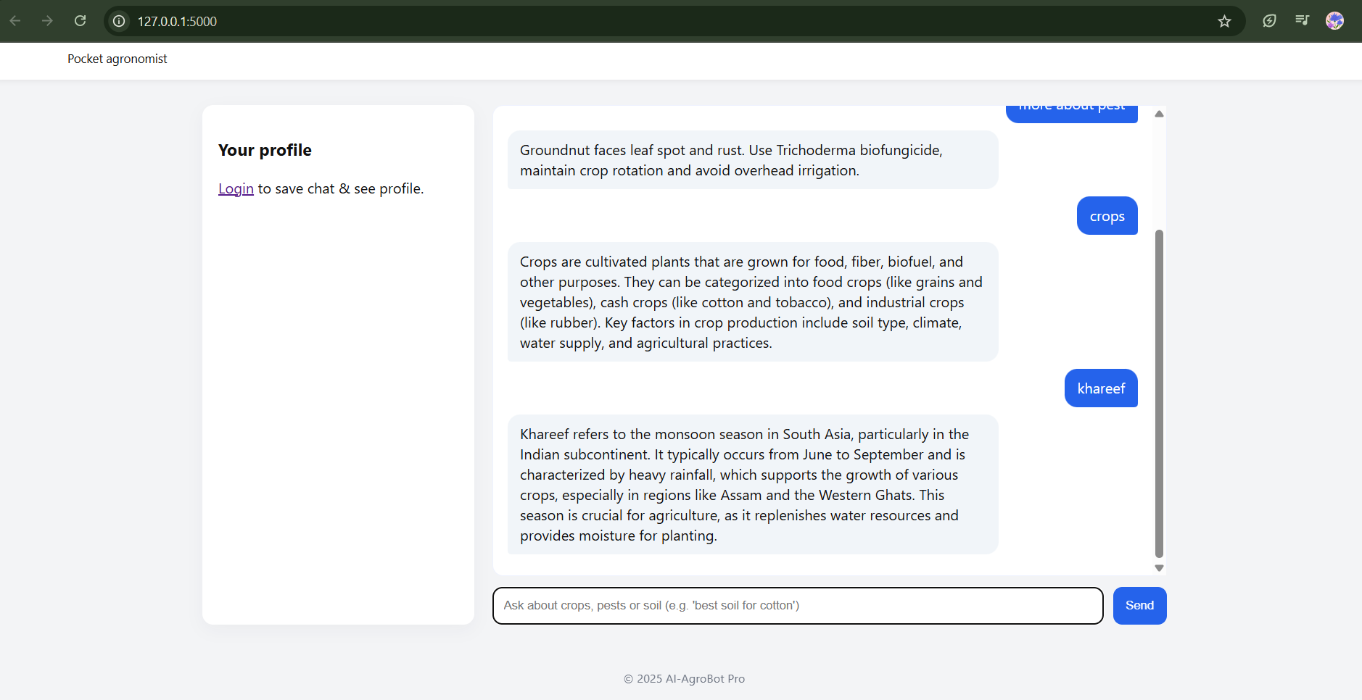
User Interface Without Login

Slide 12
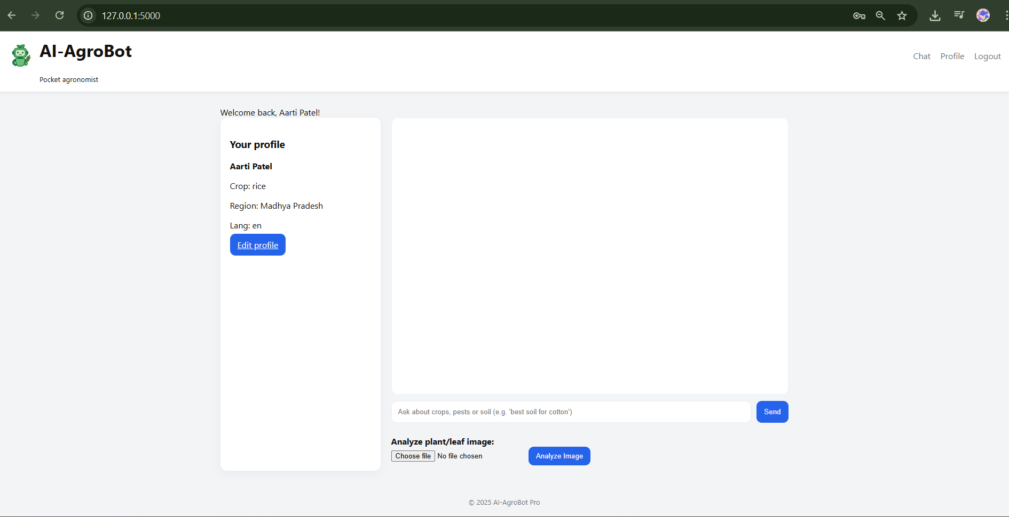
User Interface :

Slide 13
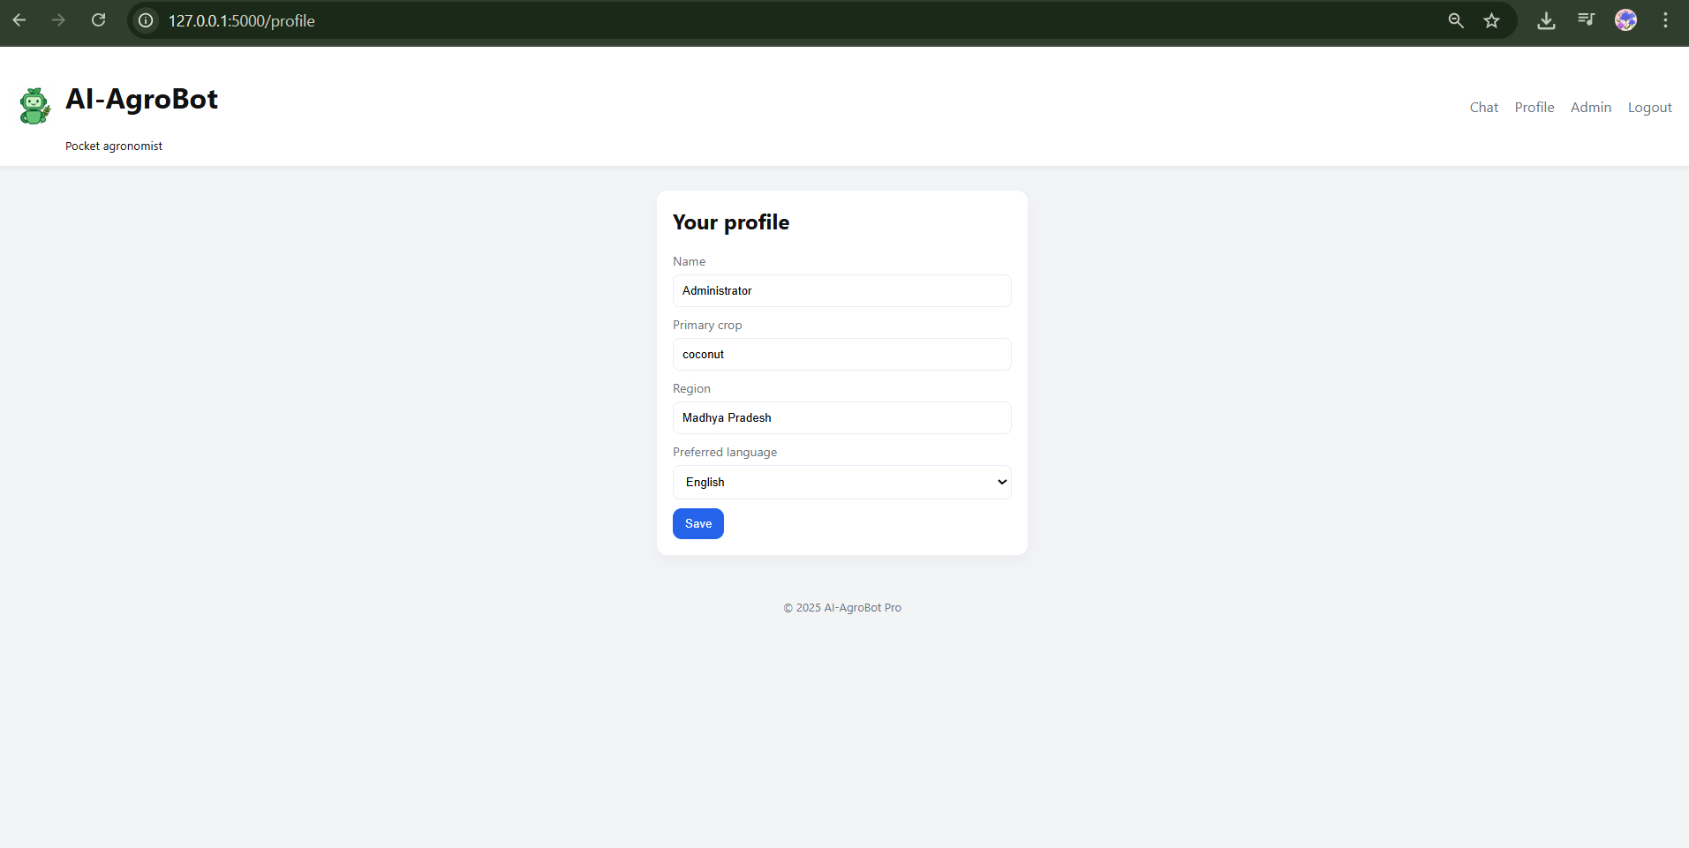
Admin Profile:

Slide 14
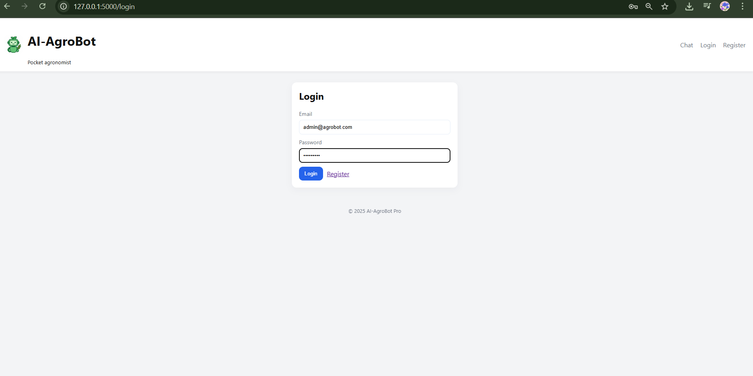
Admin Login:

Slide 15
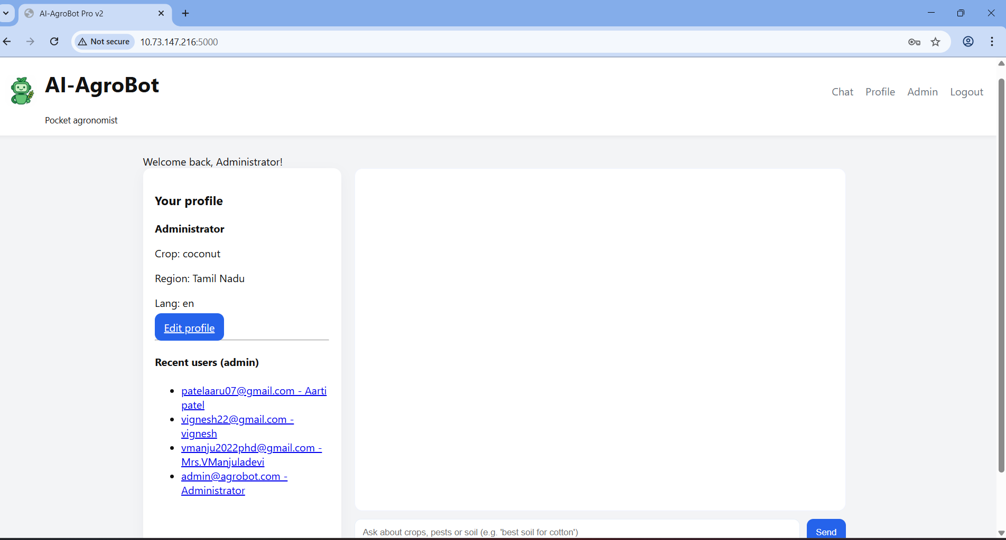
Admin Dashboard:

Slide 16
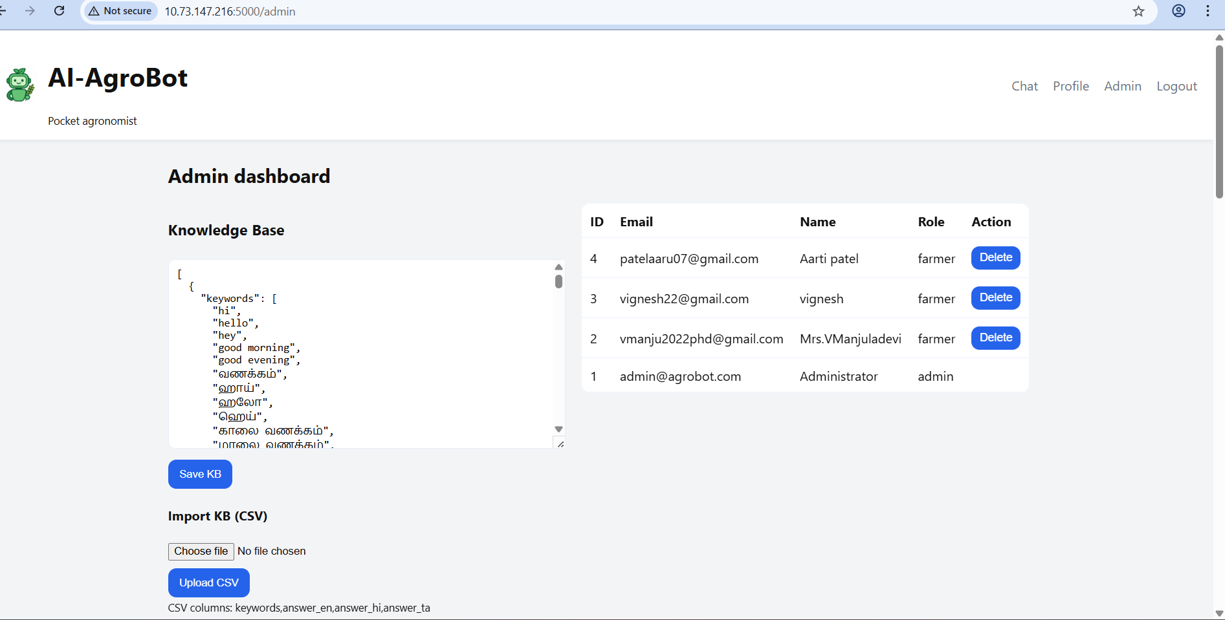
Admin Dashboard:

Slide 17
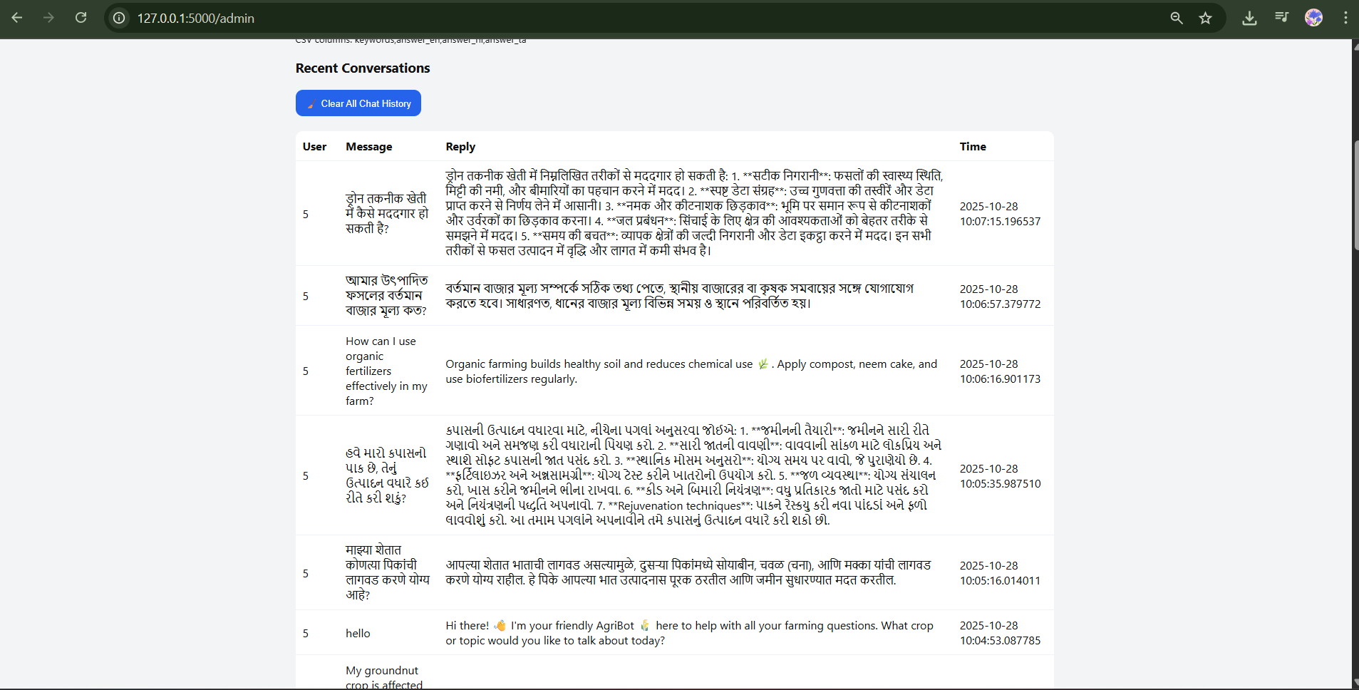
Recent Chat History :

Slide 18
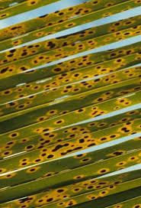
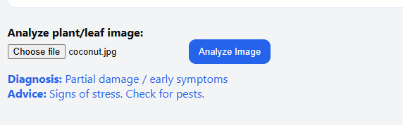
Image Analysis:
Output After Analysis
Input Image (coconut.jpg)

Slide 19
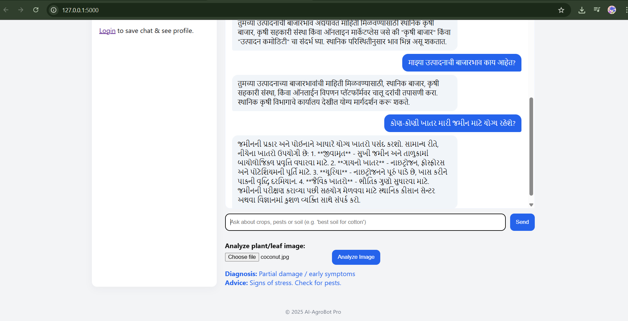
Multi Language:

Slide 20
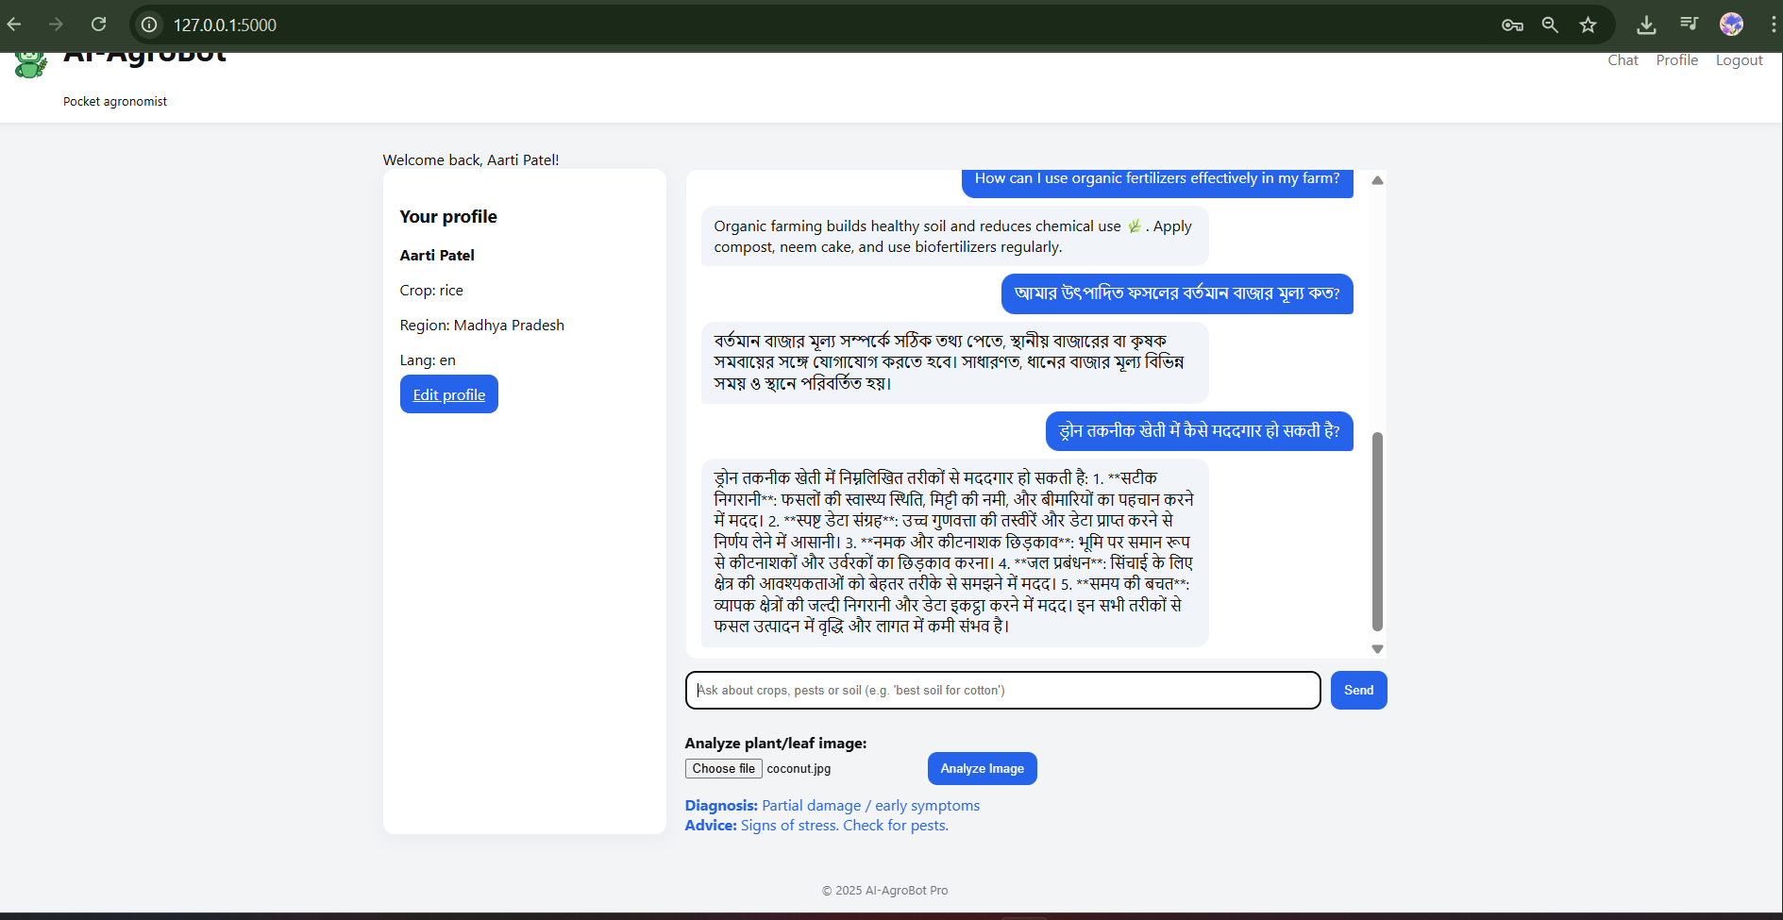
Agrobot Output :

Slide 21
Technology Stack
Backend Framework
Data Management
Python Flask
SQL & CSV
Lightweight, flexible web framework enabling rapid development and easy integration with AI services.
Hybrid storage solution balances structured user data with flexible agricultural knowledge repositories.
Frontend Technologies
AI Engine
HTML, CSS, JavaScript
OpenAI API
Modern web standards ensure responsive design and smooth user interactions across all devices.
State-of-the-art language models power natural language understanding and image recognition capabilities.

Slide 22
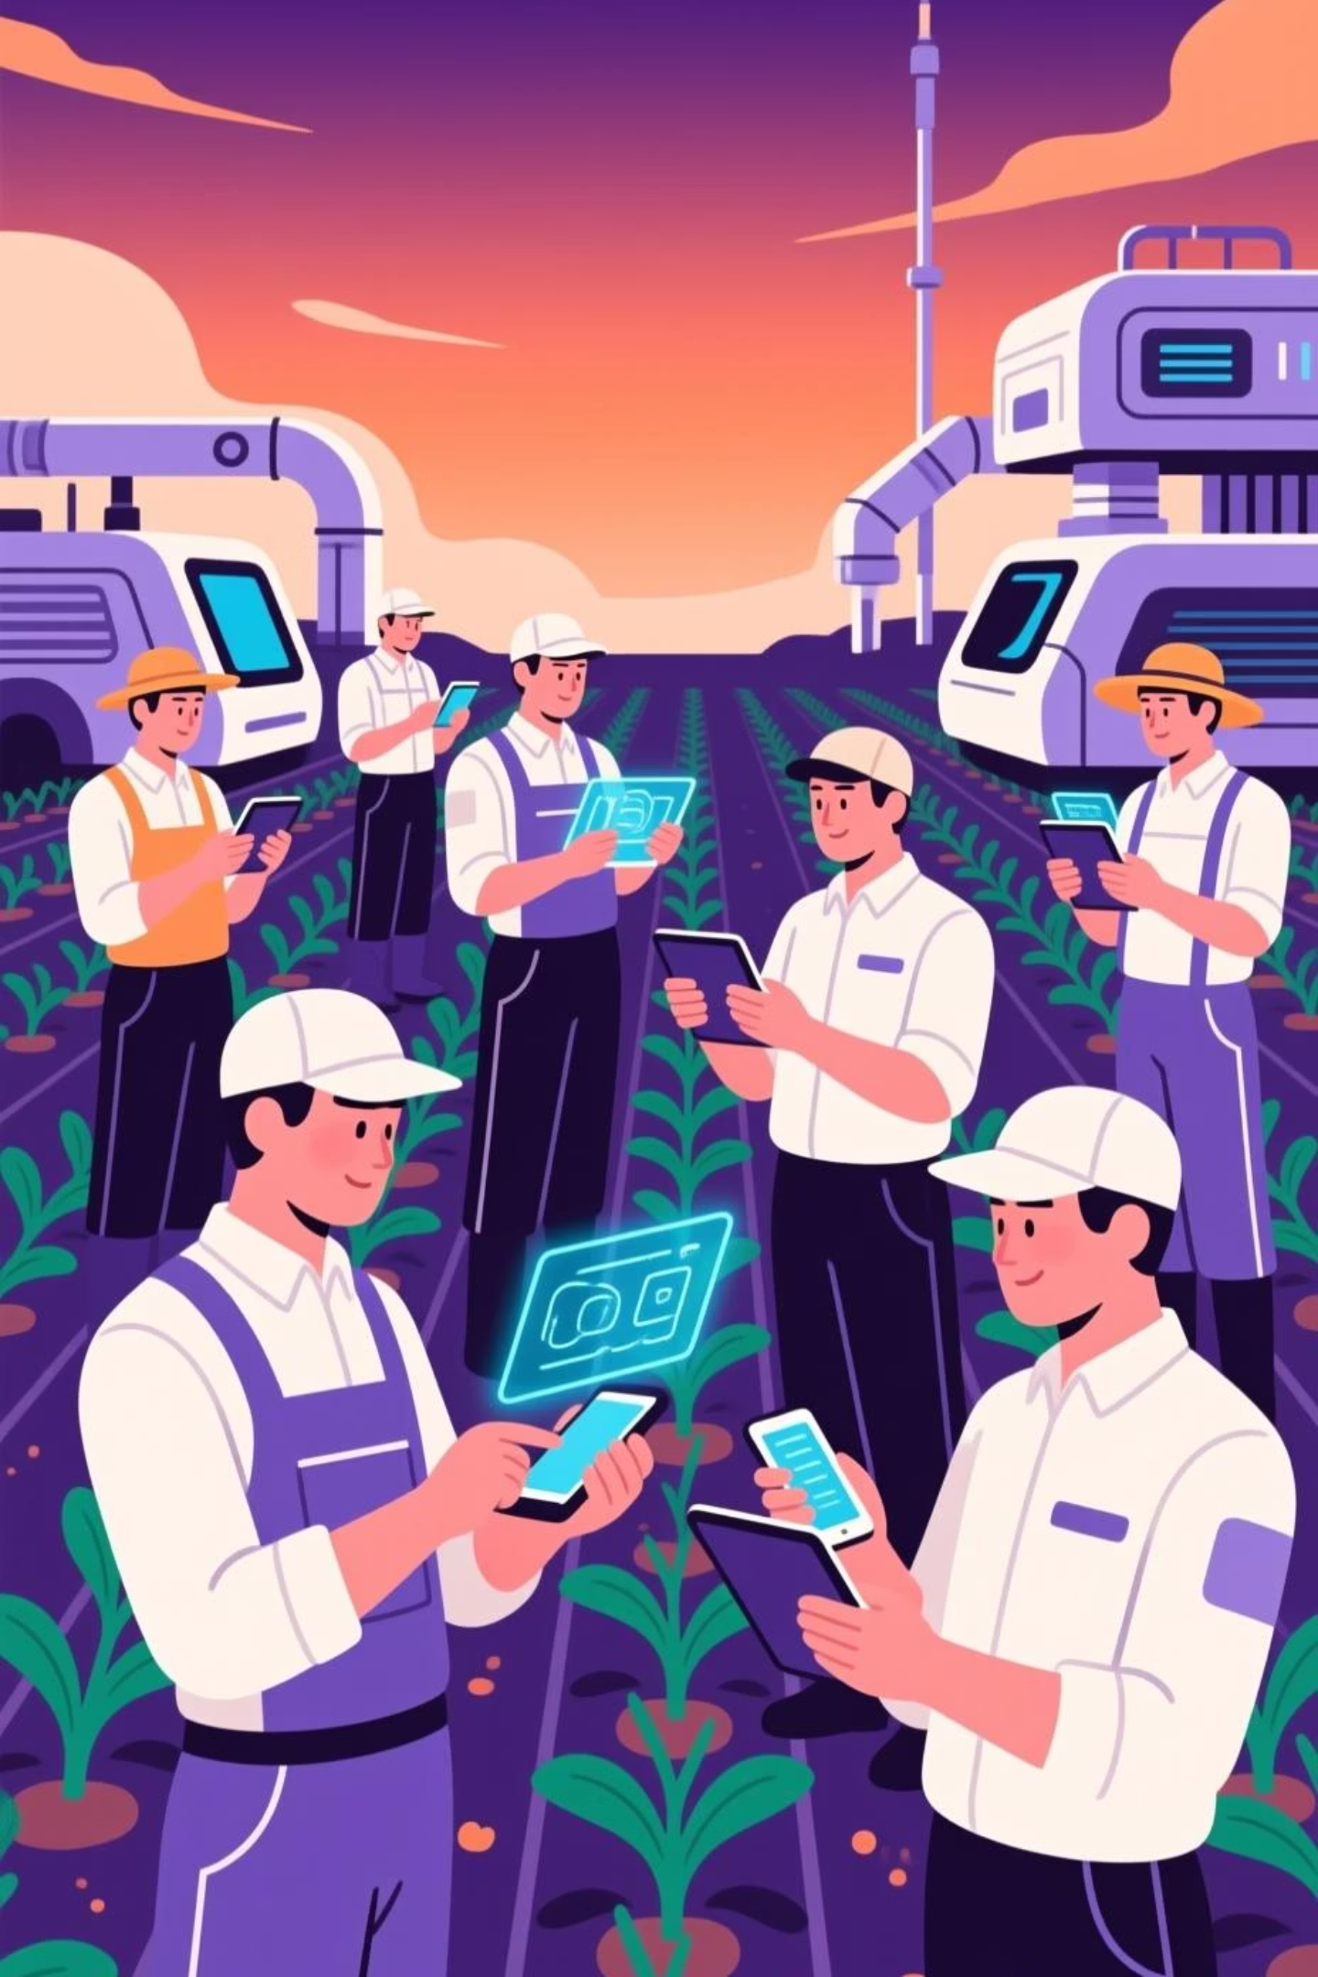
Future Development Roadmap
AgroBot Universal is continuously evolving to serve farmers better with cutting-edge features and expanded accessibility.
1
Voice-Based Interaction
Enable hands-free operation with speech recognition and audio responses, perfect for farmers working in the field.
2
Expanded Language Support
Add support for 20+ additional regional languages and dialects, reaching underserved farming communities globally.
3
Native Mobile Applications
Launch dedicated iOS and Android apps with offline capabilities, camera integration, and push notifications for timely alerts.

Slide 23

Thank You!

